Slide 1
Analysis of US Housing Market Over Time
CSCI 5609 VISUALIZATION
The Housing Homies
Akshat Ghoshal
Rohan Shanbhag
Marcus Spotanski
Notes:
"Hi everyone, our presentation is on analysis of Us housing market over time.

Slide 2
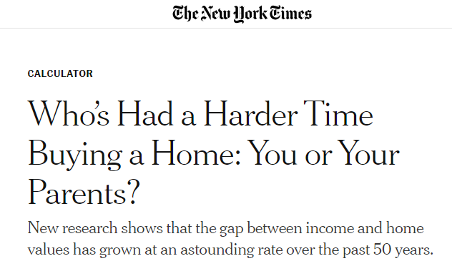

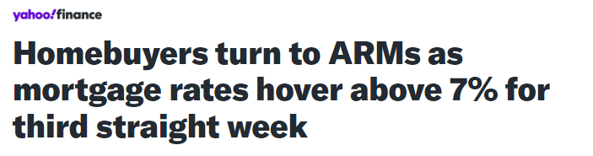
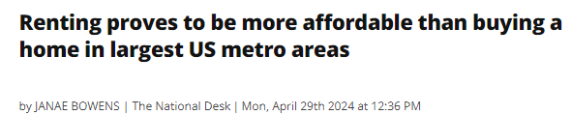
Motivation
Notes:
The housing market has been in the headlines recently as housing prices have gotten increasingly unaffordable. Our goal is to answer the key questions how has the housing market changes over time.

Slide 3
Project Goals
Identify Housing Trends Across State Lines
Compare Multiple Key Data Points in the Housing Market
Share Data in Easy to Read and Digestible Format
Where is it the easiest to afford a home>
How much do I need to bring in to afford a home in X state? Does it differ across the country?
Housing Price Index (HPI), Median Household Income, Median Home Sales Price, Mortgage Rates, etc.
Create Dashboard that allows the user to move form one figure to another to come to their own conclusions about the market.
Notes:
Our key goals is to to identify housing trends across states by comparing key data points and presenting the information in an interactive, easy-to-understand format.

Slide 4
Key Data Points
01
02
03
Housing Price Index (HPI)
Median Home Sale Price
Median Household Income
04
05
06
Minimum Income Needed
Mortgage Rate
Monthly Payment
Shows change in Housing Prices over time from a fixed point in time. Shown in percentages
The price a typical home sales for in a given state in at a given point of time.
Total Income Brought in by Household (1-2 people)
Minimum monthly income a household needs to afford the median home in a given state at a given point of time.
Interest rate of the loan taken to pay for house.
Based on a mortgage rate and down payment, this is the amount of money used to pay off the mortgage on the home purchased.
Notes:
We'll analyze the following key data points in more detail in our visualization

Slide 5
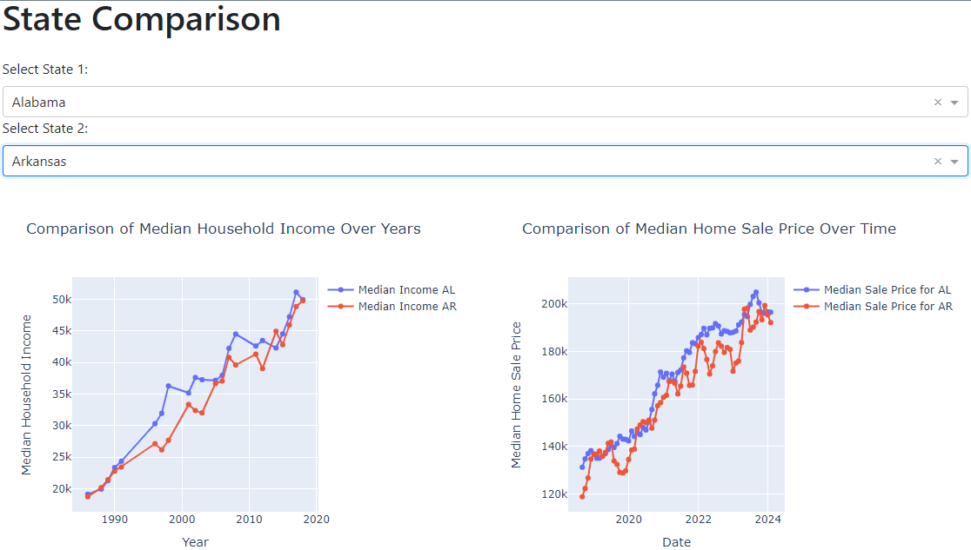
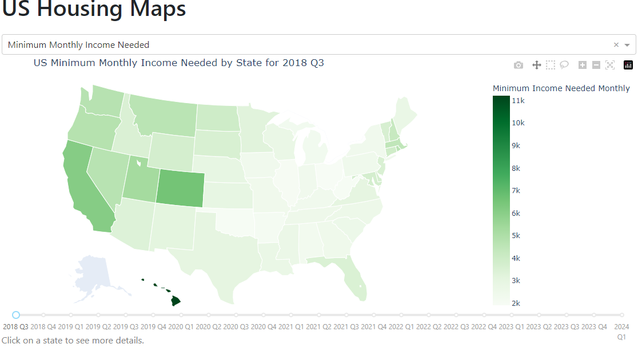
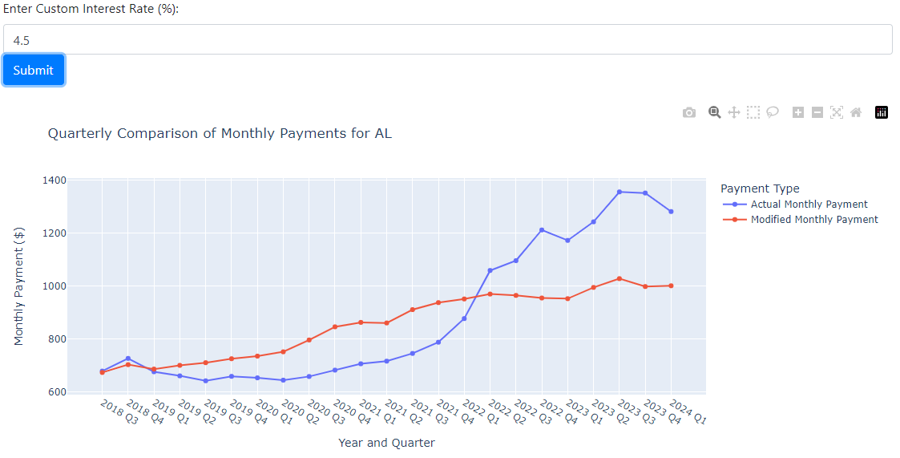
The Dashboard

Slide 6
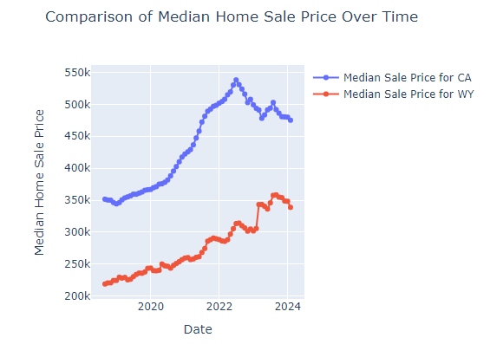
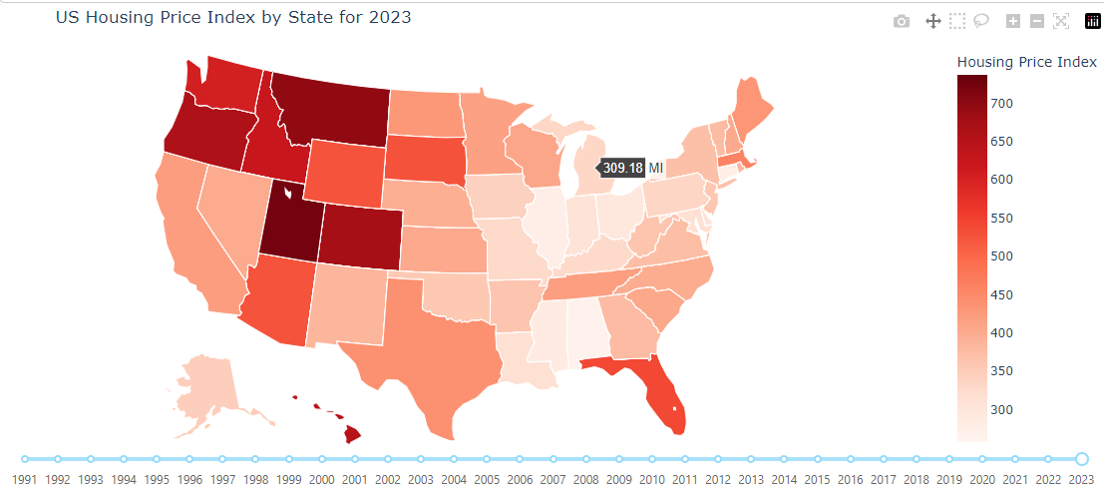
Key Trends:
Northwest vs Coasts

Slide 7
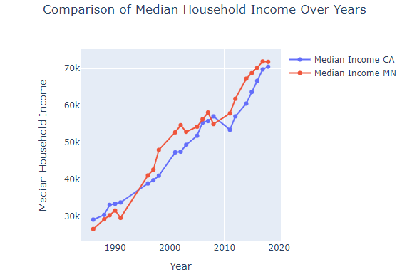
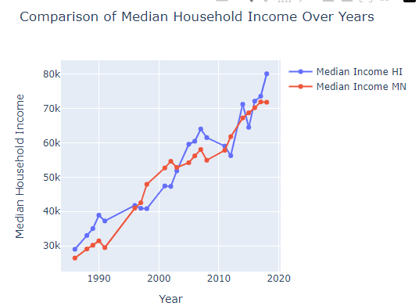
Key Trends:
Low Income Variance in Surprising States

Slide 8
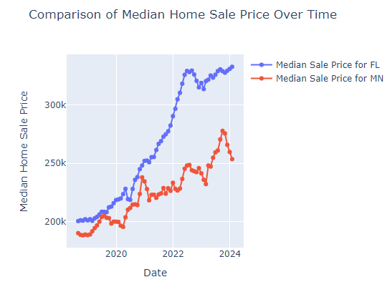
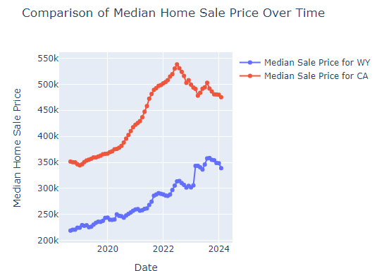
Key Trends:
Large Differences in Housing Costs

Slide 9
Techniques Used from Course
#4
#3
#2
Multi-
Dimensional Data
#1
Interactivity & Querying
Channels & Marks
Colors
Notes:
Colors – Colors were used to highlight data points, with varying hues allowing greater visual specificity towards differences between data, such as the that between housing price indices between states
Channels & Marks – Engaging visualization channels like line graphs, maps and tables helped our marks distinguish between crucial data trends and points
Interactivity & Querying – By incorporating data on demand (i.e. hovering to reveal information, interactivity through clicking, scrolling and zooming) we provide a more engaging visual experience
Multi-dimensional data – By integrating multiple data sources, we were able to derive data like the minimum monthly income needed to provide deeper insights into the housing data

Slide 10
Key Takeaways
Midwest
Northwest Boom
Closer in Income to New England and West Coast states than you’d think, but with massive discrepancies to housing sales.
Studies indicate larger swarms of upper-middle class moving to Northwestern states, causing significantly larger increases in HPI.
Prices Falling?
Saving is Key
Data points of the last year suggest median home prices are in a trend downward, but hard to determine if here to stay given interest rates being so high, and overall increases country wide
Based on the Minimum Income Required graph, most people are close to affording the median home, but many don’t due to the large down-payment, credit concerns, and acquiring large sums of debts. Saving more of your income for larger down payments makes the homes more accessible, but the most challenging.

Slide 11
Future Work
Statistical Analysis on Variance of Income, Population Distributions, Geographical Area Trends
Adding in Listings, Rentals, and Population Change Data
Tying in Live API for more updated Data
Explore Relationships between State Rankings and Housing Costs
Add ability to shift data from State to County Level for more in-depth analysis

Slide 12
THANK YOU!

